Slide 1

B.N.M. Institute of Technology
An Autonomous Institution under VTU
Approved by AICTE, Accredited as Grade A Institution by NAAC till 31.12.2026.
All Eligible UG branches – CSE, ECE, EEE, ISE & Mech. Engg. Accredited by NBA till 30.06.2025
Post box no. 7087, 27th cross, 12th Main, Banashankari 2nd Stage, Bengaluru- 560070, INDIA
Ph: 91-80- 26711780/81/82 Email: principal@bnmit.in, www.bnmit.org
INTRODUCTION TO IOT (22ETC/E/M 115)
(Project Based Learning Course)
“ SMART GREENHOUSE SYSTEM ”
CHANDANA T S CHINMAYI N DEEPIKA DEVIDAS KANTRIKAR HASINI D
22CSA33 22CSA37 22CSA39 22CSA58
Under the guidance of
Dr. SHUBHA RAO K
Associate Professor
Dept. of EEE, BNMIT

Slide 2
Contents
INTRODUCTION
MOTIVATION
OBJECTIVE AND SCOPE
HARDWARE AND SOFTWARE REQUIREMENTS
METHODOLOGY
Block Diagram
Description Of The Project
RESULTS
CONCLUSION AND FUTURE SCOPE
REFERENCES

Slide 3
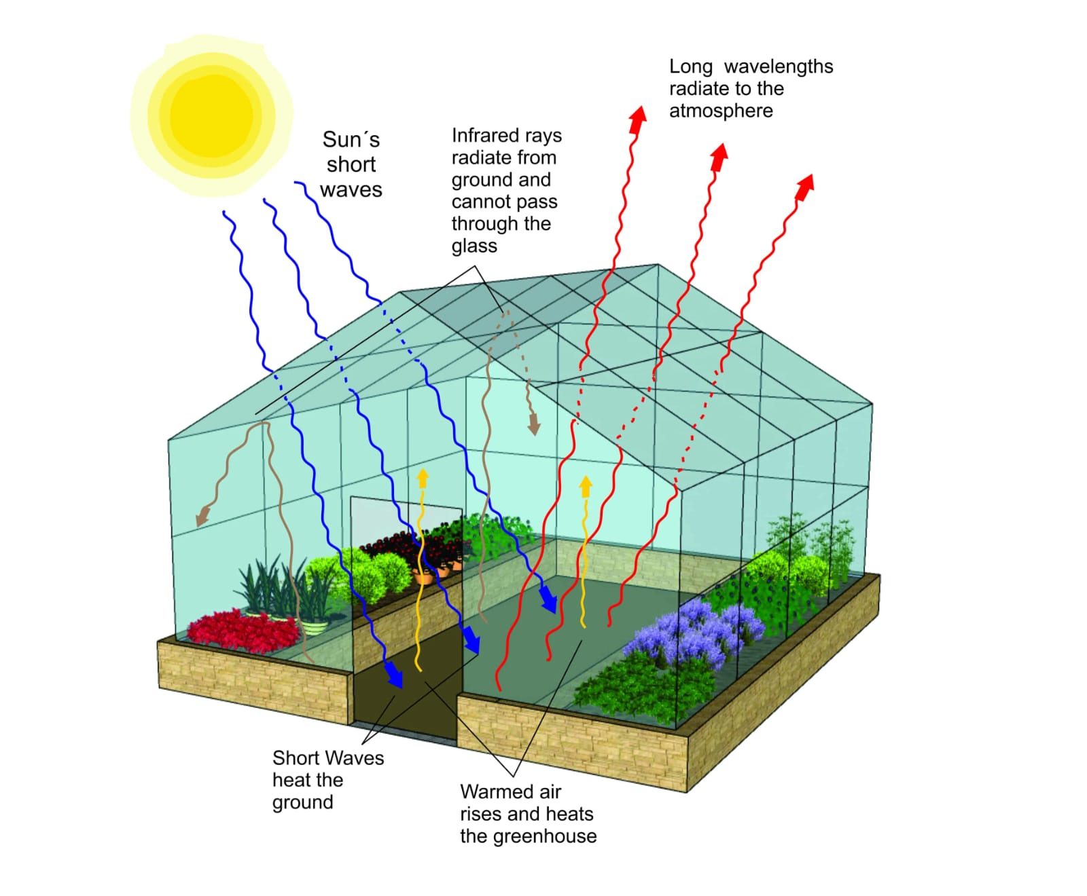
INTRODUCTION
Internet of Things (IoT) refers to the network of physical devices, vehicles, home appliances, and other items embedded with sensors, software, and connectivity that allows them to connect and exchange data over the internet.
One area where IoT has had a significant impact is in agriculture, where it has made it possible to create smart greenhouses and monitoring.
A greenhouse is a building with glass walls and a glass roof.
Greenhouses are used to grow plants in a controlled environment, and with the help of IoT, it is now possible to monitor and control various parameters such as temperature, humidity, soil moisture, and light intensity.
IoT-based greenhouse systems use sensors to collect data on various environmental factors and transmit it to a central control system. This system uses this data and make decisions on adjusting environmental parameters to optimize plant growth.

Slide 4
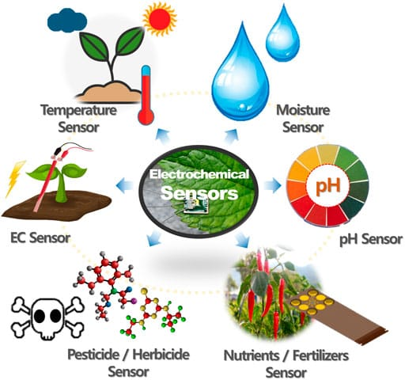
MOTIVATION
Usage of most significant technologies in 21st century i.e. wireless sensor network and internet of things(IOT) in modern greenhouses, botanical gardens to trace the parameters and ensure proper operation in greenhouse automation system , made us to motivate.
With this system farmers can control their greenhouse from their mobiles or computer from different place through net connections.
Easy Automation and Control.
Energy efficiency.
Remote monitoring and control.
Reduce labour costs.
Easy data collections and analysis.
More Environmental benefits.

Slide 5
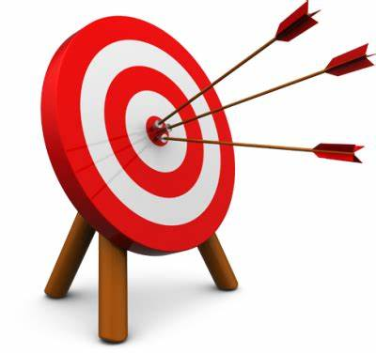
OBJECTIVE
Easy of accessing and simplicity on maintenance
Advanced connectivity of physical objects over a wide network
To build miniature greenhouse which is equipped with automatic monitoring and controlling system
Constantly monitoring
Control environmental conditions in greenhouse
It focuses on saving water.
Increases efficiency and reducing the environmental impacts on plant production such as pesticides and fertilizers.
User can see the atmospheric conditions of the greenhouse plants on website and control the greenhouse from far away places
VISION: our vision is to design a greenhouse monitoring system based on IOT. We also show how computing technology and wireless technology is invading our greenhouse.

Slide 6
REQUIREMENTS:
a) HARDWARE | DESCRIPTION
ESP 32 | Microcontroller.
Relay module. | Acts as switch ON/OFF purpose.
LCD [Liquid Crystal Display] | Display the Data collected.
Cable and jumper wires. | Used for connections.
Sensor : DHT11 Soil moisture LDR | Check Temperature and Humidity . Check Moisture of the sensor. Check for Light intensity.
Actuators : Fan Motor Led | Act as output when Temperature is high , FAN get ON . Acts as output when Soil is dry , Motor get ON . Acts as output when Light is less , LED get ON provide artificial light .

Slide 7
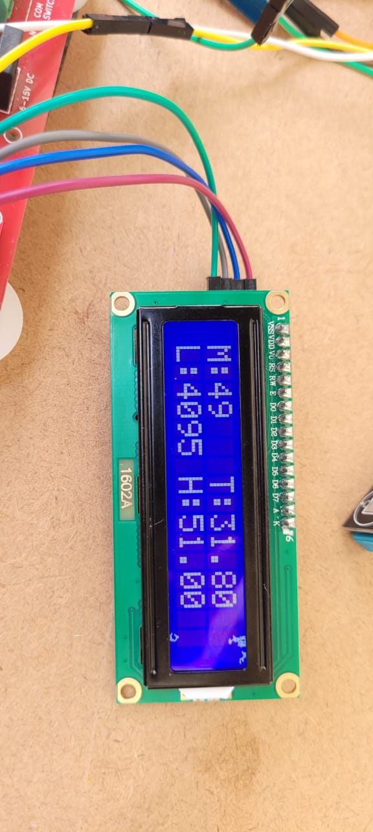
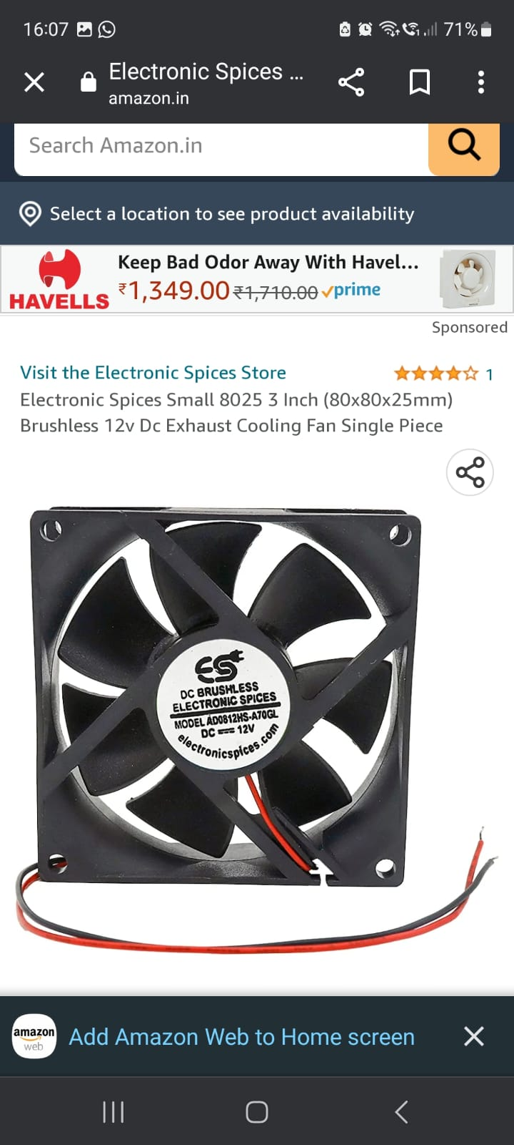
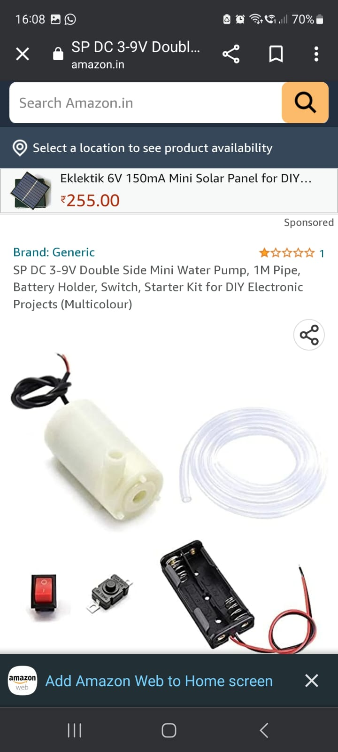
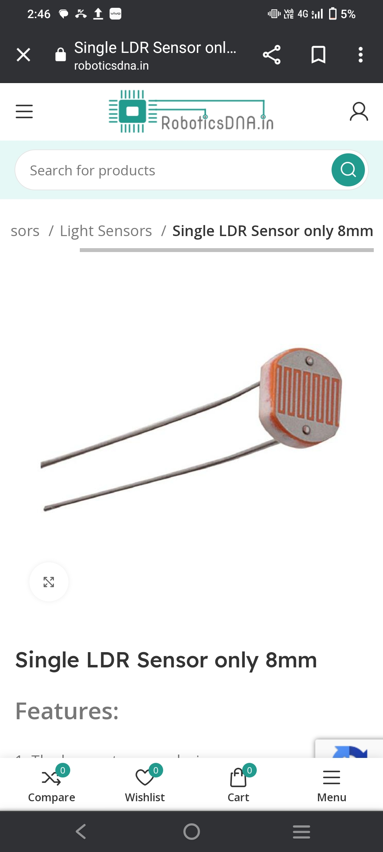
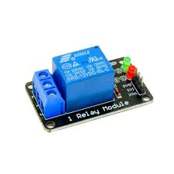
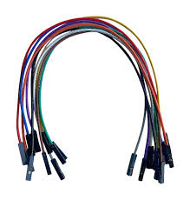
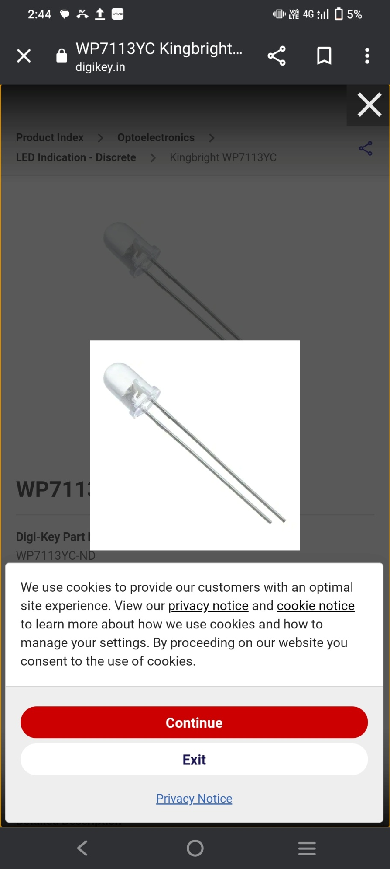
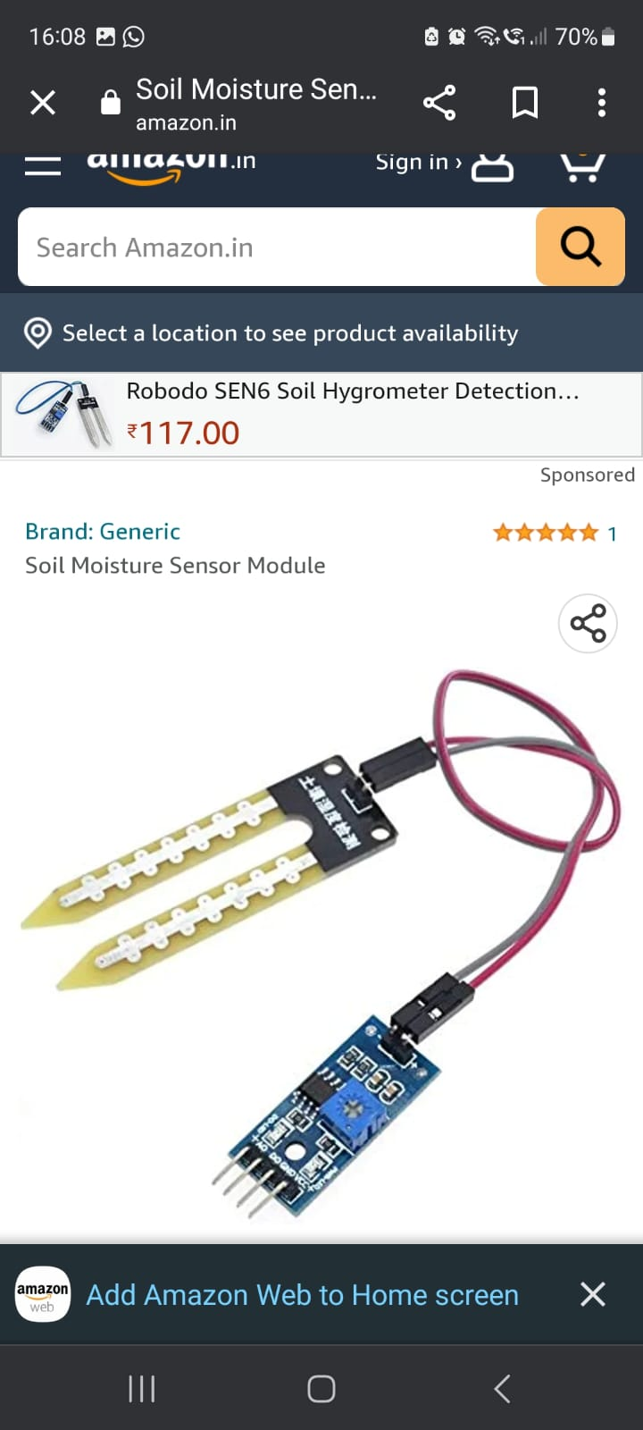
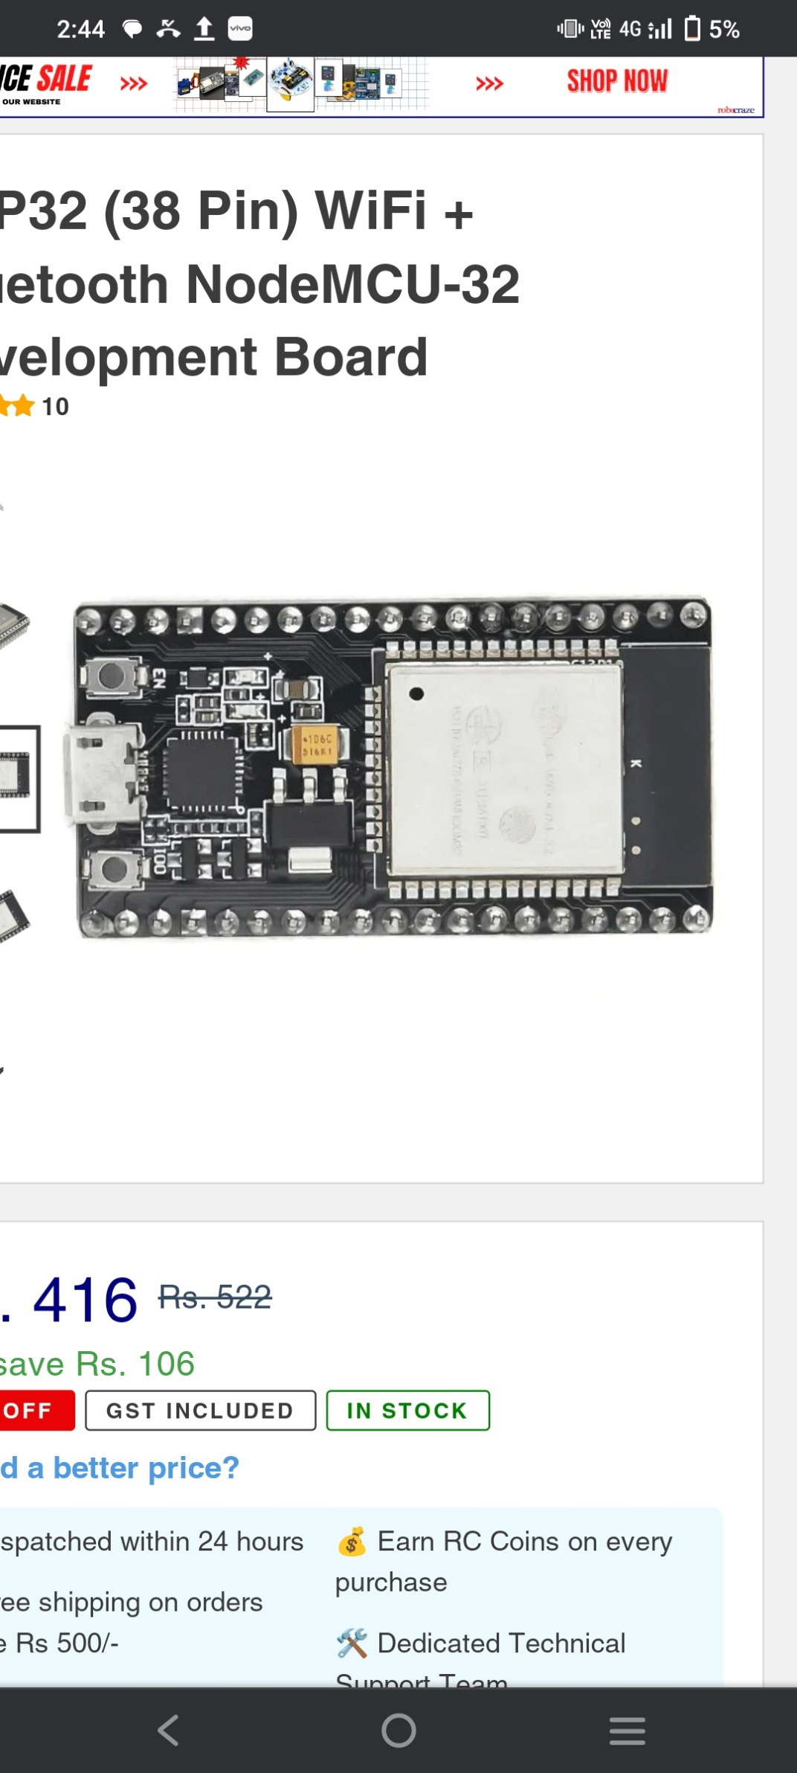
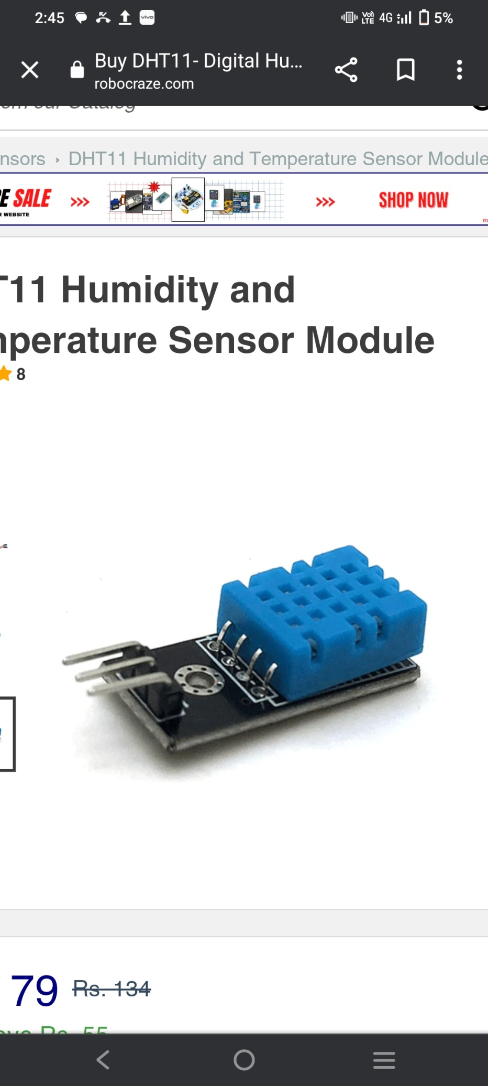
M O T O R
L C D
L D R
R E L A Y
F A N
L E D
J U M P E R W I R E
ES P 32
D H T 11
S O I L M O I S T U R E SENSOR

Slide 8
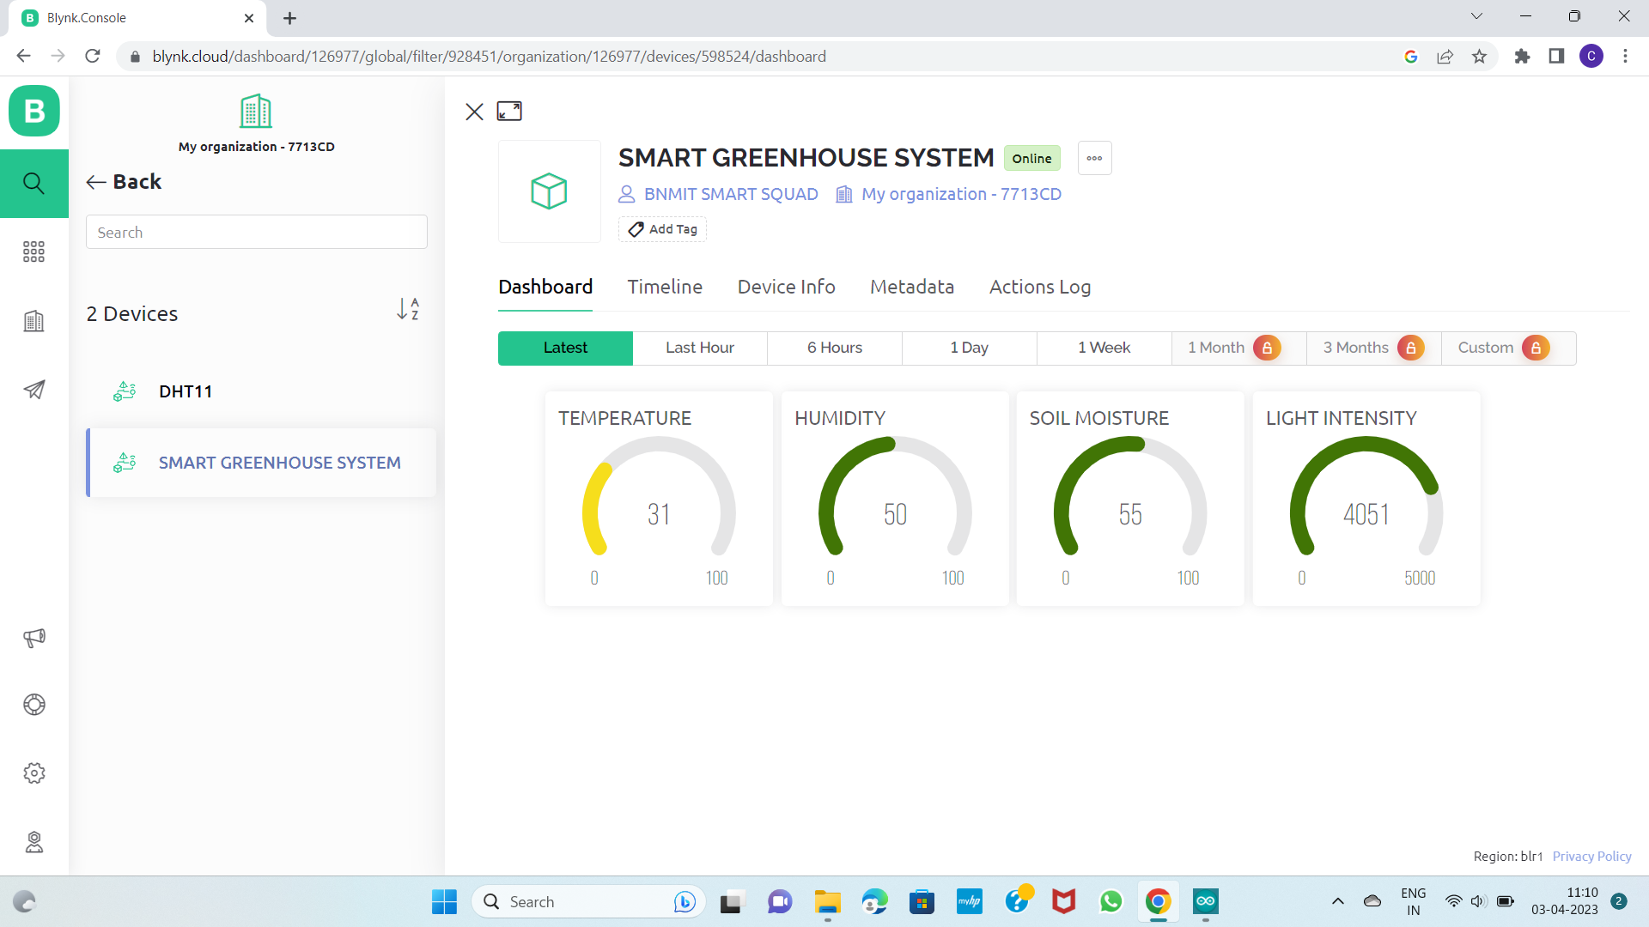
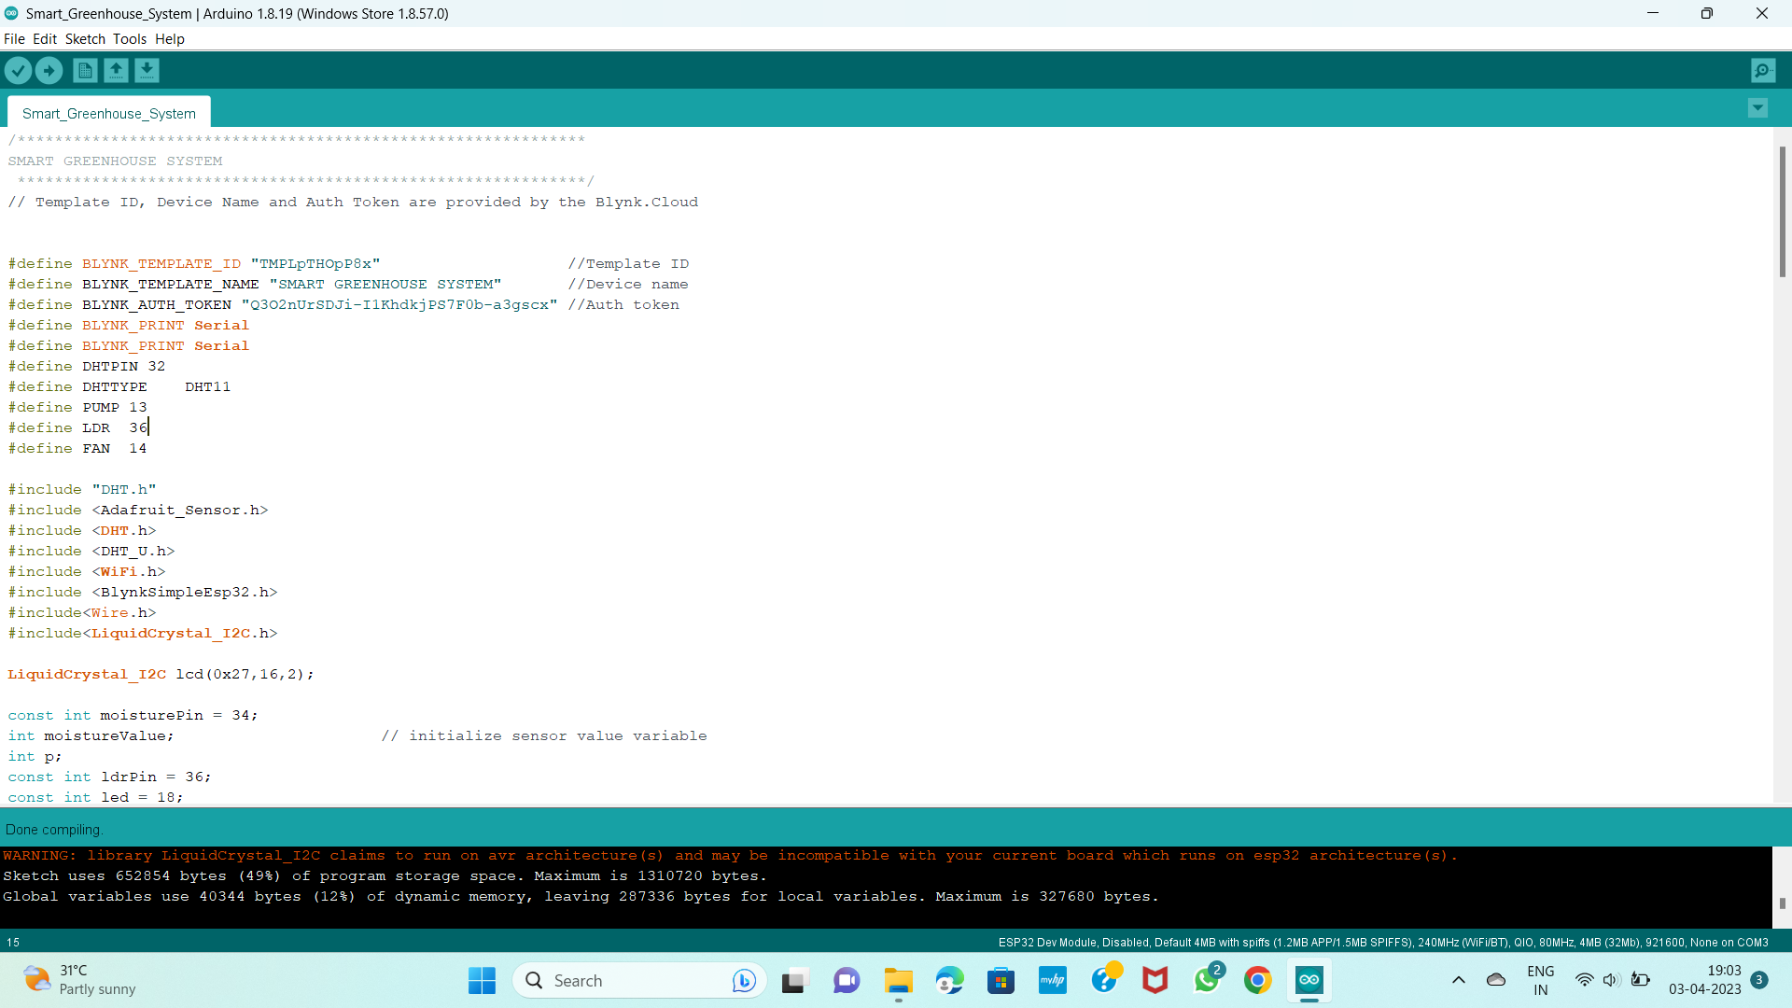
SOFTWARE | DESCRIPTION
ARDUINO IDE | The programming app.
BLYNK APP | The Blynk is the mobile application used to display sensor display which acts as an interface between user and IOT devices.
BLYNK APP DISPLAY
ARDUINO IDE

Slide 9
METHODOLOGY
Block Diagram:
POWER SUPPLY
FAN
TEMPERATURE & HUMIDITY SENSOR
RELAY MODULE
MOTOR PUMP
MOISTURE SENSOR
MICRO CONTROLLER
LED
BLYNK
LIGHT SENSOR
REMOTE DEVICE
(16* 2) LCD DISPLAY

Slide 10
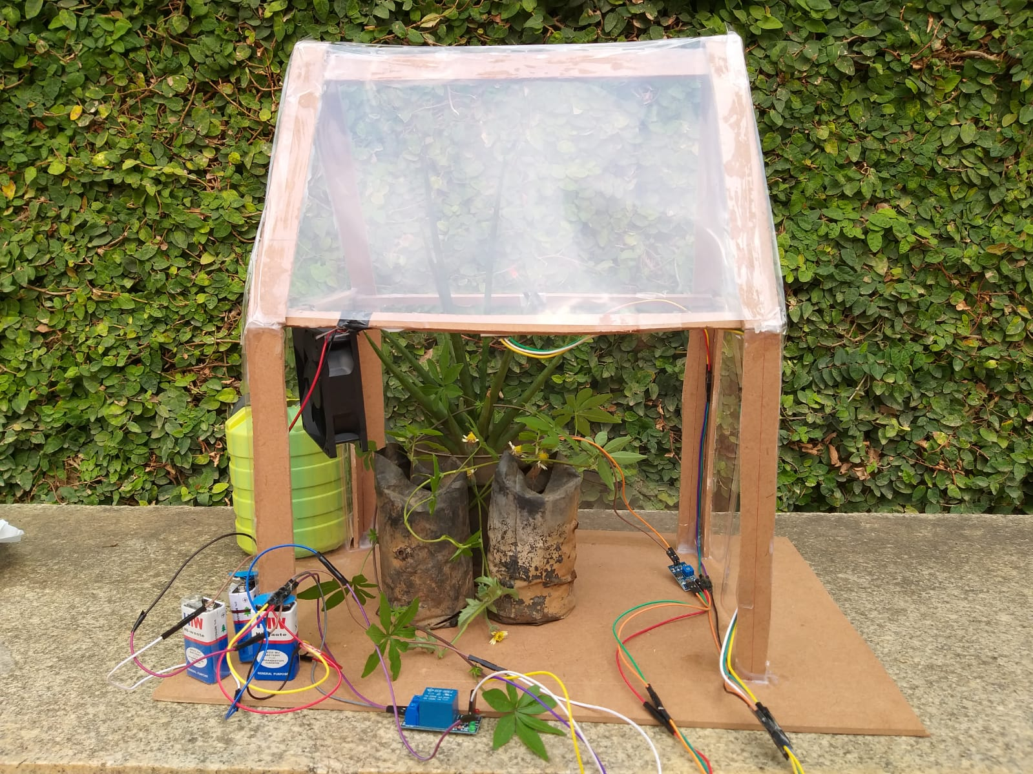
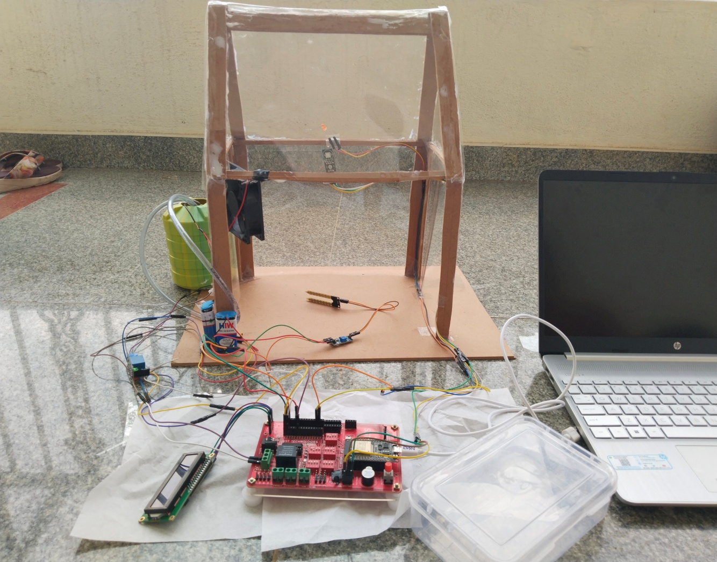
Display of our project:

Slide 11
Description Of The Project
Our project on greenhouse monitoring through (IoT) technology involves the use of sensors like LDR, DHT11, and soil moisture to collect data on the environmental factors affecting plant growth in the greenhouse. In addition to these sensors, the project also includes the use of actuators such as a fan, motor, and LED to control and manipulate the environmental factors and the information collected are displayed on LCD and through Blynk app, user can monitor the parameters continuously.
Pin 13,14,18 is set as OUTPUT and it is connected to Pump ,FAN , Led respectively.
Pin 34,32,36 is set as INPUT and it is connected to soil moisture sensor, DHT11,LDR respectively.
When soil moisture sensor range is BELOW 40% , HIGH signal is sent to Relay module and relay will switch on the MOTOR, thus water flow and soil moisture is maintained and vice versa.
When LDR range is BELOW 1000 lux , HIGH signal is sent to Relay module and relay will switch on the LED thus light intensity is maintained and vice versa.
When DHT11 range is ABOVE 25, HIGH signal is sent to Relay module and relay will switch on the FAN thus temperature is maintained and vice versa.
All the above collected data is displayed on LCD [liquid crystal display] and on user’s cell through BLYNK app.

Slide 12
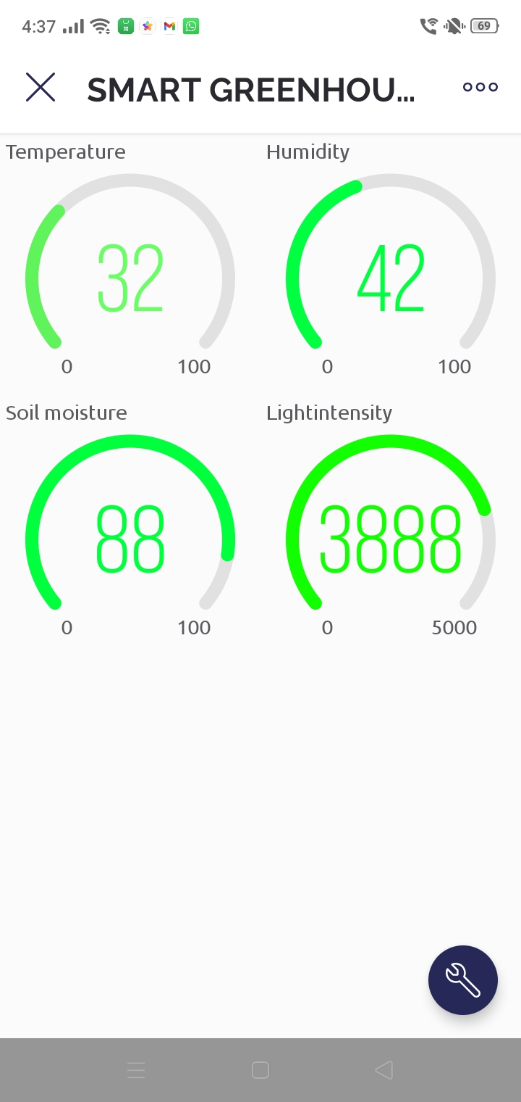
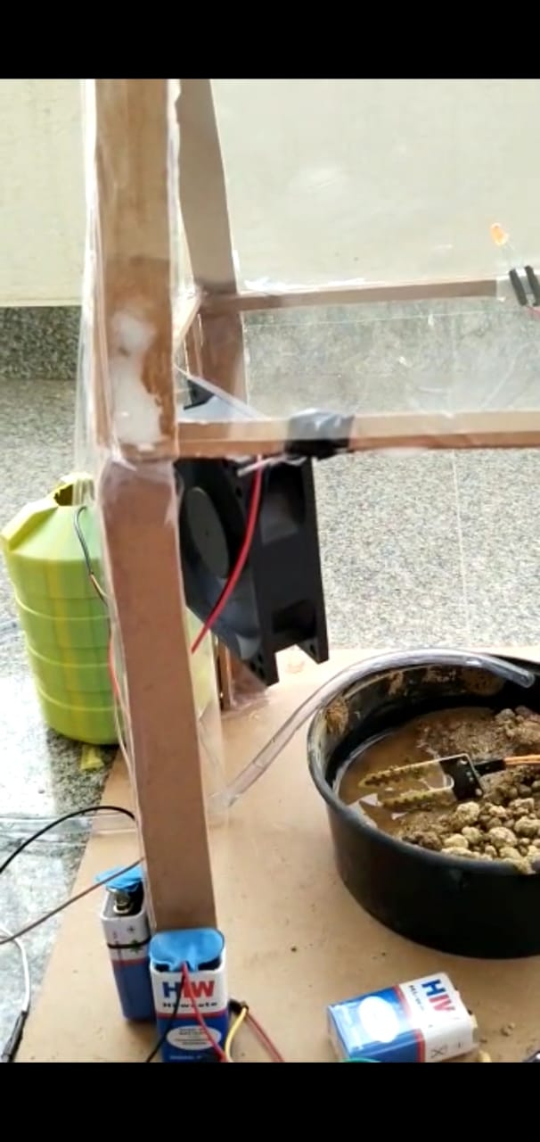
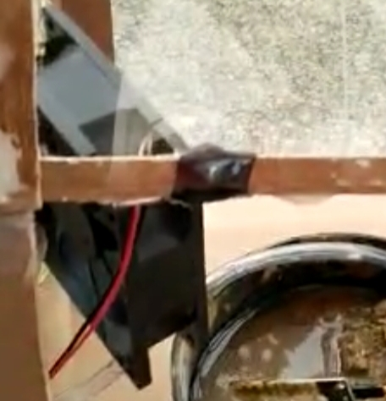

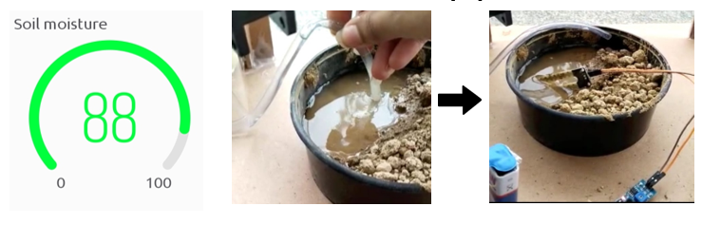
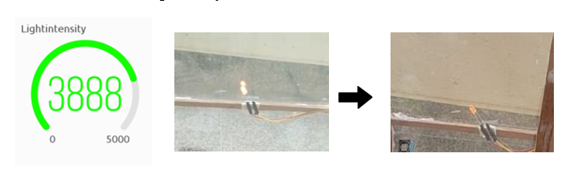
BLYNK DISPLAY
OUTPUT

Slide 13
BLYNK APP
The BLYNK is the mobile application used to display sensor display
The threshold values of our smart greenhouse system are :
Temperature – 25 degree indicates green colour, 26-35 degree indicates yellow , above 35 degree indicates red colour
Humidity -50% - GREEN Colour , 50-55% - YELLOW Colour and 55% - RED Colour
Soil moisture – 40% - GREEN Colour , 40-35% - YELLOW Colour and 40% - RED Colour
Light intensity – 1000 lux - GREEN Colour , 999-800 - YELLOW Colour and 800 - RED Colour
DESCRIPTION OF COLORS USED IN BLYNK
Green: controlling all the parameters and greenhouse is in safe condition.
Yellow: a little variations in controlling the parameters and greenhouse is edge of safe condition.
Red: a large variations in controlling the parameters and greenhouse is in unsafe condition.

Slide 14
RESULTS
All sensors should sense the data and fetch the environmental conditions and send the data to arduino. Sensors which include DHT11 , SOIL MOISTURE , LDR.
The sensed data by the sensors is displayed on LCD display.
If there is variations in the sensed data/values, it performs an appropriate action in order for crop yield. such as:
If temperature is greater than 25 degree celcius, FAN gets ON and vice versa.
If moisture content is less than 40%, motor pump turns ON and vice versa.
If light intensity if less than 1000lux, LED turns ON and vice versa.
the data sensed by the sensors is getting updated on the Blynk application.
This provides real time analysis, reduces the amount of resources, improves efficiency and ensue optimal growing conditions for plants.

Slide 15
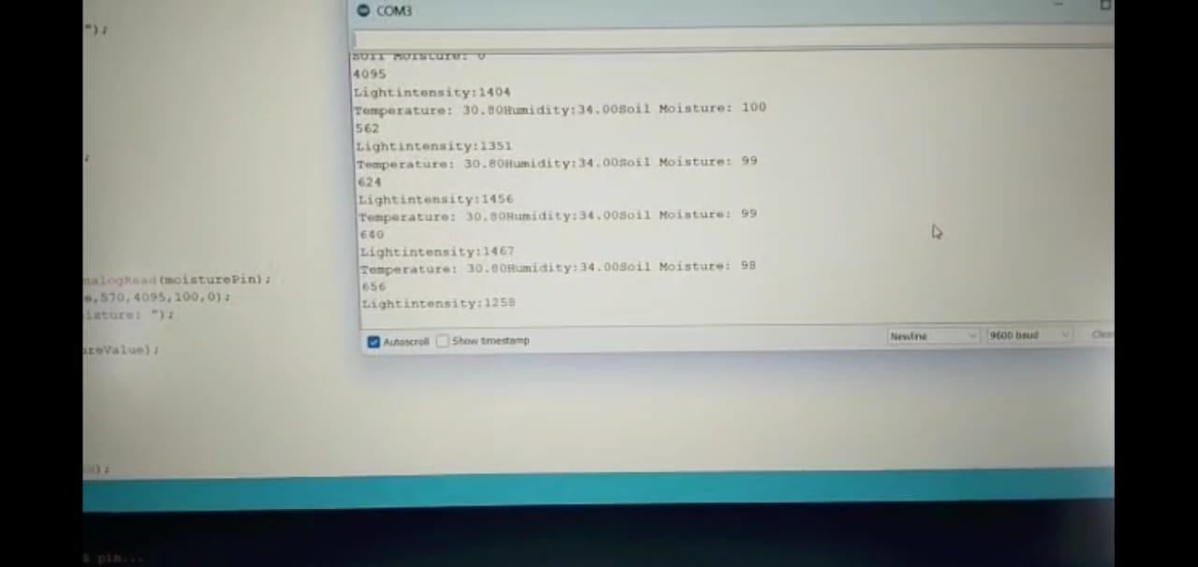
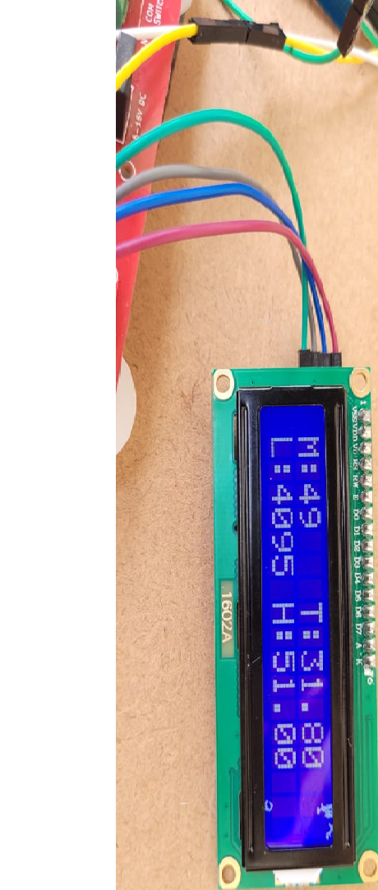
SERIAL MONITOR DISPLAY
LCD DISPLAY
BLYNK DISPLAY

Slide 16
CONCLUSION
There are ways to make a smart move towards the need of agriculture field. Technology of today's era is providing hand in improvement. Agricultural professional and the management have to look in this matter. In conventional farming, we have to face lots of problems.
With help of technology we can able to produce insecticide and pesticide free crops and create a suitable environment for the proper growth of plants.
Most important the smart customer of today's era are directly connected to the farmer. So, farmer knows the requirement of end users that improve the quality of crops.
The ability to remotely monitor and control the greenhouse environment using a smartphone or other device makes it easier for growers to manage their crops and respond quickly to any issues that arise.

Slide 17
FUTURE SCOPE
A smart greenhouse system would be a system that automatically controls the temperature and humidity conditions in a greenhouse using IoT devices and sensors. The system would be able to monitor the environmental conditions in the greenhouse, such as temperature, light intensity and soil moisture levels, and adjust the conditions to ensure optimal plant growth.
However, there are some challenges to implementing a smart greenhouse system. Firstly, the cost of setting up the system could be prohibitive for small-scale farmers, and the technology may not be accessible or affordable in certain regions. Additionally, there would be concerns around the security of data and the reliability of the IoT devices.
A smart greenhouse system has the potential to revolutionize greenhouse farming and improve efficiency and sustainability in agriculture. However, it is important to consider the challenges and limitations of implementing such a system.

Slide 18
REFERENCES:
“Green House Automation Using IOT” by JET. “IOT Greenhouse”: https://youtube/owlkoisfyy.
Interaction Journal of creative research thoughts (IJCRT) “IOT Based Smart Greenhouse Automation”. By: Pranjali .D.Shiyali, Hemangi Thombre, Gautam Tyagi, Aarti Chauhan.
Prince Immanuel Alexander.S, Dineshkumar.J, Lavanya.G. “IOT Based Greenhouse Monitering Controlling’. 2018 IJRTI.
IRJET June 2020, www.irjet.net “IOT Based advanced greenhouse system”. By: Pooja p Korade, Amrutha A Pandav, Varsha R Kamble.
YOUTUBE: https://youtu.be/ju51LORqblw
https://youtu.be/RUdTPZAVwy8

Slide 19


